Slide 1
Encoding Categorical Data
It refers to the process of converting categorical or textual data into numerical format, so that it can be used as input for algorithms to process. The reason for encoding is that most machine learning algorithms work with numbers and not with text or categorical variables.

Slide 2
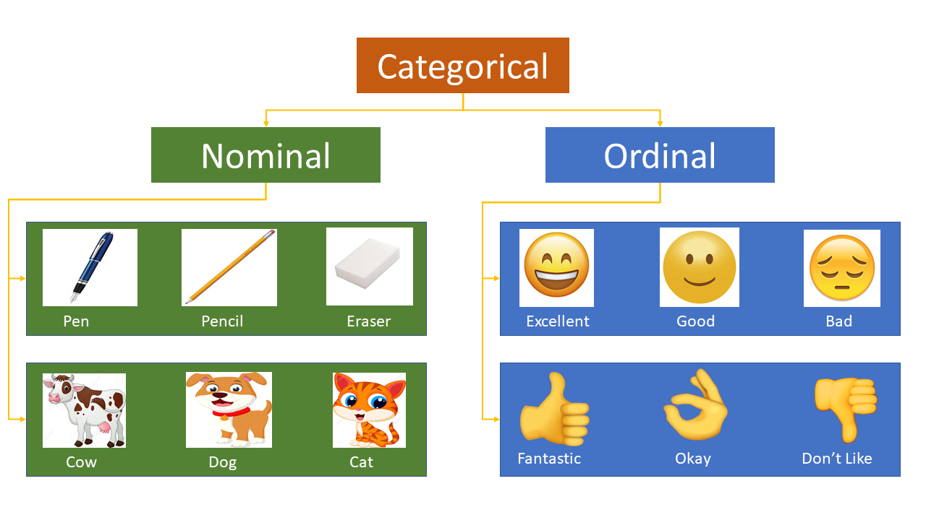
Type of categorical data

Slide 3
Encoding technique
Ordinal Encoding
One-hot Encoding
Label Encoding

Slide 4
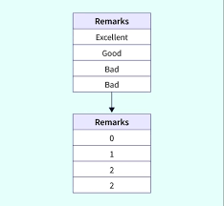
Ordinal Encoding:
Ordinal encoding is a technique to transform categorical features into a numerical format. In ordinal encoding, labels are translated to numbers based on their ordinal relationship to one another.

Slide 5
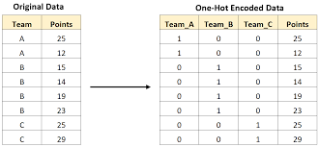
One-hot Encoding:-
One hot encoding is one method of converting data to prepare it for an algorithm and get a better prediction. With one-hot, we convert each categorical value into a new categorical column and assign a binary value of 1 or 0 to those columns. Each integer value is represented as a binary vector.

Slide 6
Label Encoding:-
Encode target labels with value between 0 and n_classes-1.
This transformer should be used to encode target values, i.e. y, and not the input X.
Target | Encoding
Yes | 1
Yes | 1
No | 0
Yes | 1
No | 0
No | 0

Slide 7
Feature Scaling Technique
Feature Scaling is a technique to standardize the independent features present in the data in a fixed range. It is performed during the data pre-processing to handle highly varying magnitudes or values or units. If feature scaling is not done, then a machine learning algorithm tends to weigh greater values, higher and consider smaller values as the lower values, regardless of the unit of the values.

Slide 8


Min-Max Scaling:
As we are using the maximum and the minimum value this method is also prone to outliers but the range in which the data will range after performing the above two steps is between 0 to 1.
Mean Normalization:
This method is more or less the same as the previous method but here instead of the minimum value, we subtract each entry by the mean value of the whole data and then divide the results by the difference between the minimum and the maximum value.

Slide 9

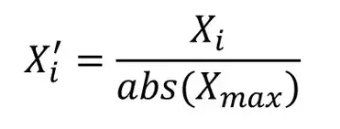
Robust Scaler:
In this method of scaling, we use two main statistical measures of the data.
Median
Inter-Quartile Range
After calculating these two values we are supposed to subtract the median from each entry and then divide the result by the interquartile range.
Max Abs Scaling:
Maximum absolute scaling scales the data to its maximum value; that is, it divides every observation by the maximum value of the variable: The result of the preceding transformation is a distribution in which the values vary approximately within the range of -1 to 1.

Slide 10

Standardization:
This method of scaling is basically based on the central tendencies and variance of the data.
First, we should calculate the mean and standard deviation of the data we would like to normalize.
Then we are supposed to subtract the mean value from each entry and then divide the result by the standard deviation.
This helps us achieve a normal distribution(if it is already normal but skewed) of the data with a mean equal to zero and a standard deviation equal to 1

